Slide 1


Travel Agency Database
Young Seok Seo (109803869)

Slide 2
Description
Managing one’s travel itinerary as travel agency
Trying to show that which customer goes specific location with selected dates with corresponding hotels and transportation
10 entities
Multiplicity (1:m , n:m relationships)
Collected data from Kaggle, https://catalog.data.gov/dataset, http://theonegenerator.com, hotels.com, skyscanner.com

Slide 3
Process
Make entities and its attributes with appropriate data type
Collected or generated data from web.
Usually collected hotel, transportation and city data
Generated customer and staff information
Build multiplicity according to RDM
Package – hotel (n:m relationship)
Package – transportation (n:m relationship)
7 one to many relationships
Make Query, Forms, and Reports

Slide 4
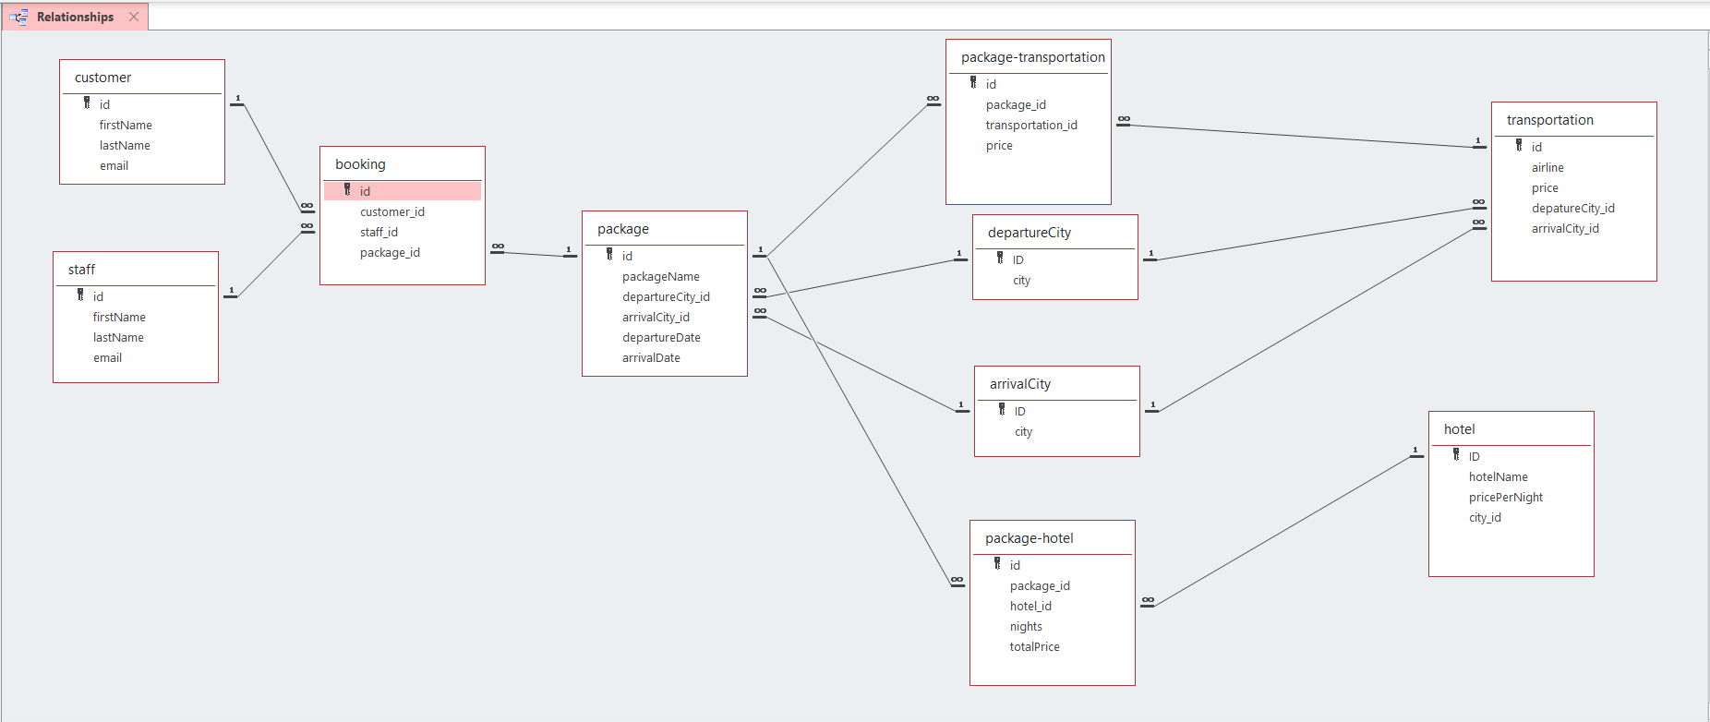

Slide 5
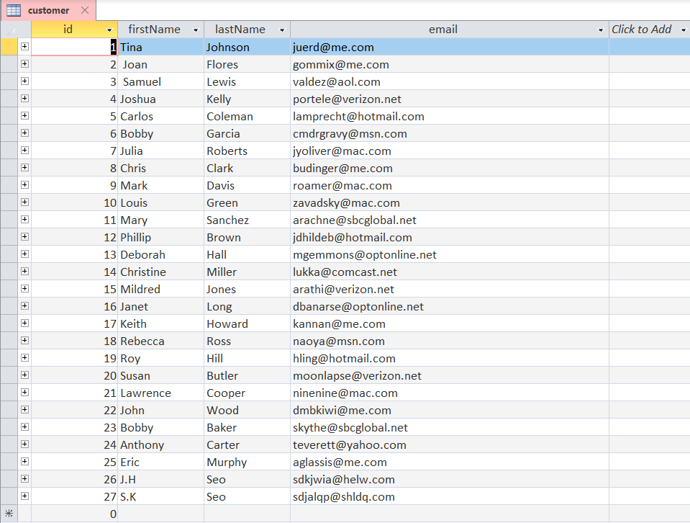
Customer
4 attributes
*Id
First Name
Last Name
Email
Total 27 customers
3NF

Slide 6
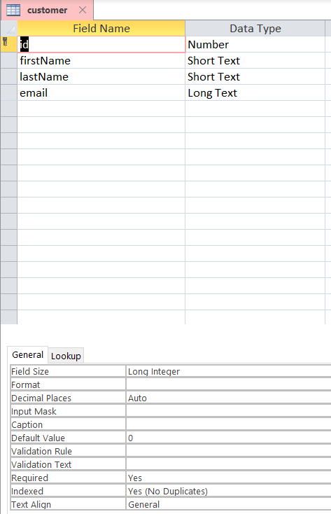
id – Number(Long Integer)
firstName – Short Text
lastName – Short Text
email – Long Text

Slide 7
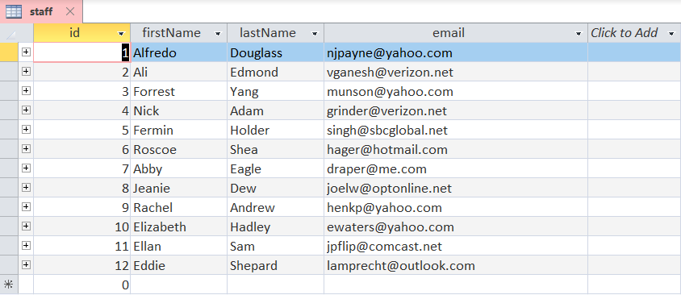
Staff
4 attributes
*Id
First Name
Last Name
Email
Total 12 staffs
3NF

Slide 8
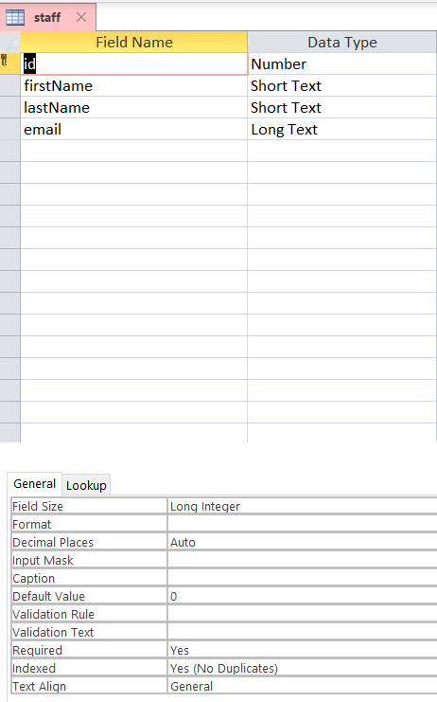
id – Number (Long Integer)
firstName – Short Text
lastName – Short Text
email – Long Text

Slide 9
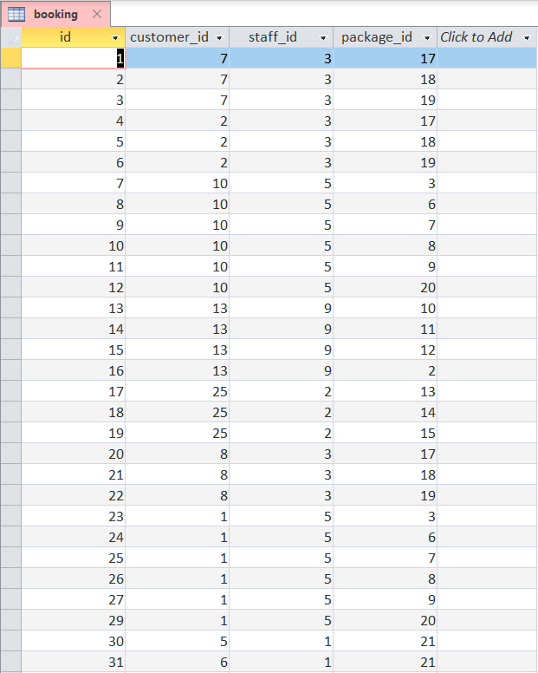
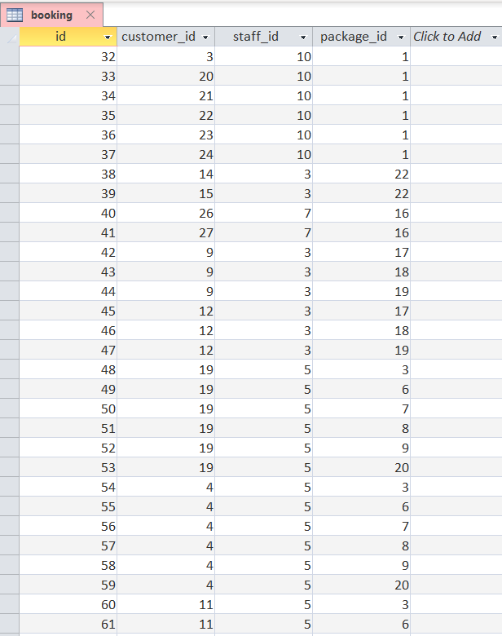
Booking
4 attributes
*Id
Customer_id - FK
Staff_id - FK
Package_id -FK
Total 65 booking records
1NF

Slide 10
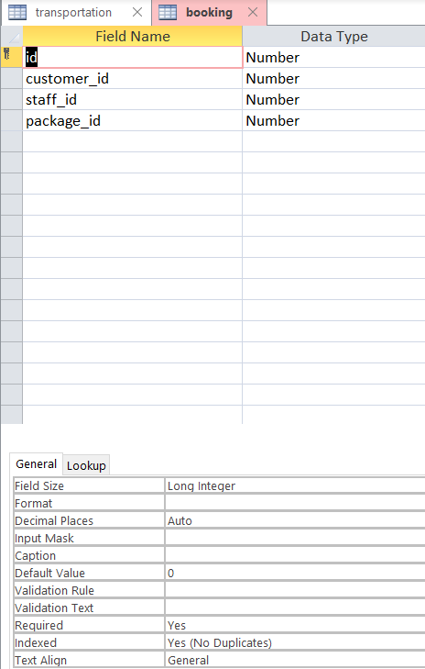
id – Number (Long Integer)
customer_id – Number (Long Integer)
staff_id – Number (Long Integer)
package_id – Number (Long Integer)

Slide 11
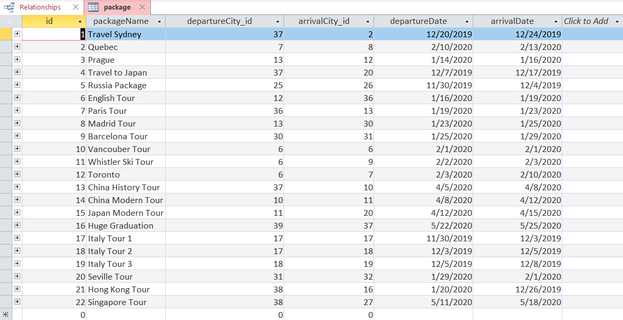
Package
6 attributes
*Id
package Name
departureCity_id - FK
arriavalCity_id - FK
Departure Date
Arrival Date
Total 22 packages
1NF

Slide 12
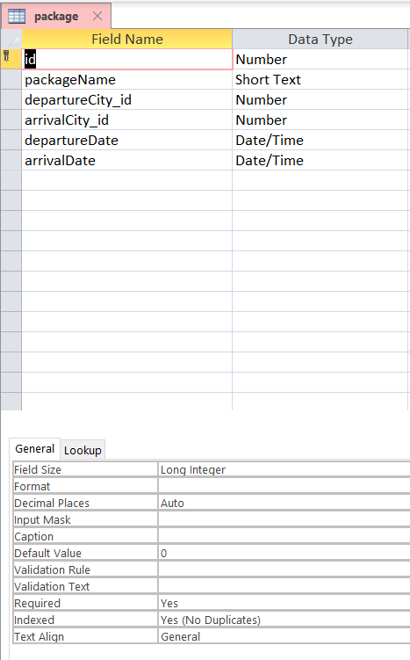
id – Number (Long Integer)
packageName –(Short Text)
departureCity_id – Number (Long Integer)
arriavalCity_id – Number (Long Integer)
departureDate – Date/Time
arrivalDate – Date/Time

Slide 13
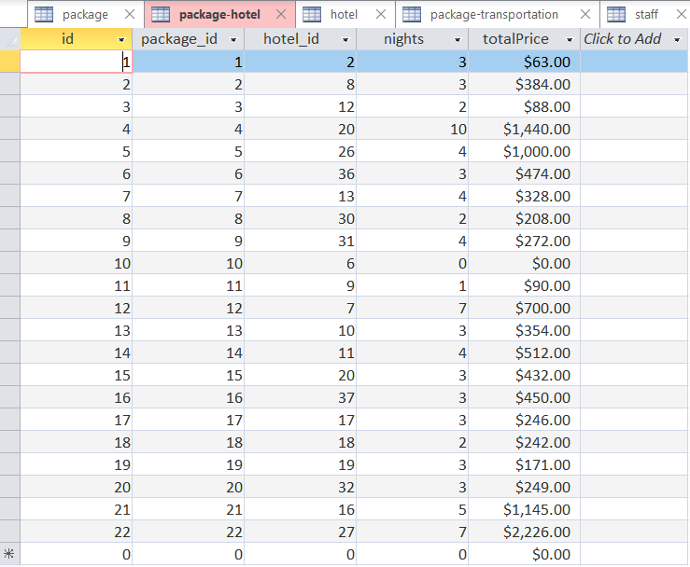
Package-hotel
5 attributes
*Id
package_id - FK
hotel_id - FK
Nights
Total Price
Total 22 package-hotel records
1NF

Slide 14
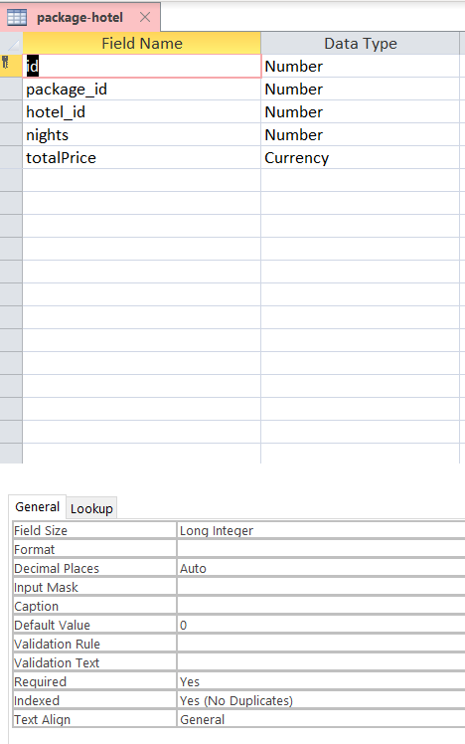
id – Number (Long Integer)
package_id –Number (Long Integer)
hotel_id – Number (Long Integer)
nights – Number (Long Integer)
totalPrice – Currency

Slide 15
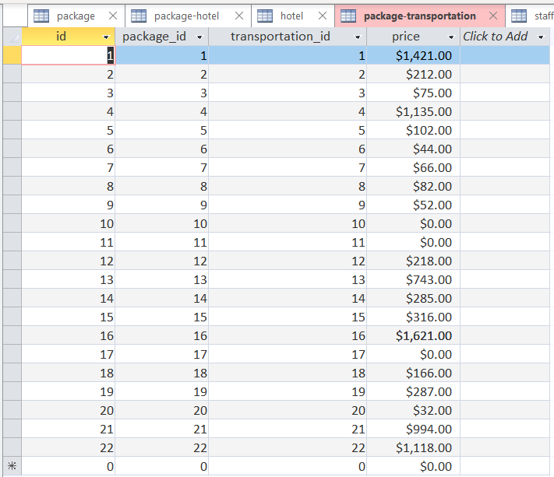
Package-Transportation
4 attributes
*Id
package_id - FK
transportation_id - FK
Price
Total 22 package-transportation records
1NF

Slide 16
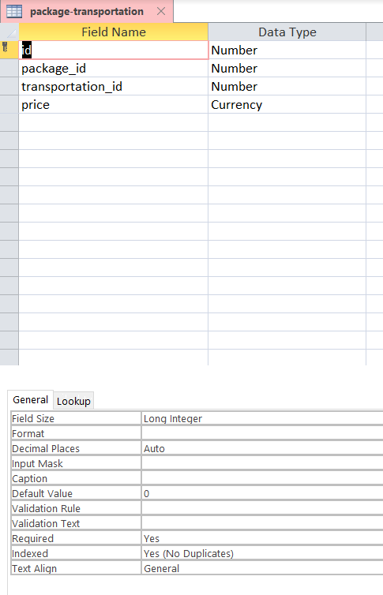
id – Number (Long Integer)
package_id –Number (Long Integer)
transportation_id – Number (Long Integer)
price – Currency

Slide 17
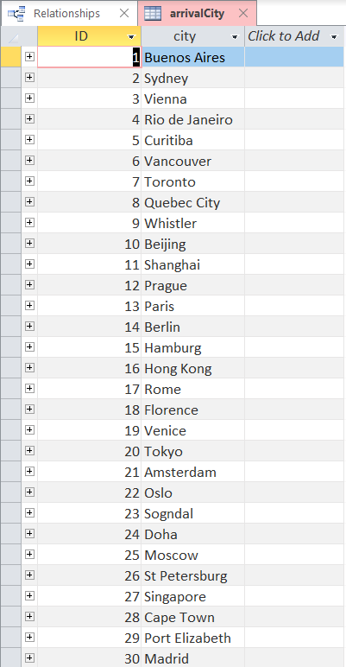
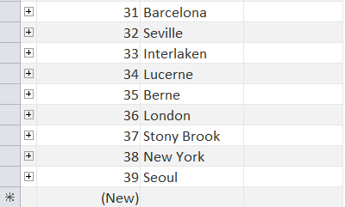
arrivalCity
2 attributes
*Id
City
Total 39 cities
3NF

Slide 18
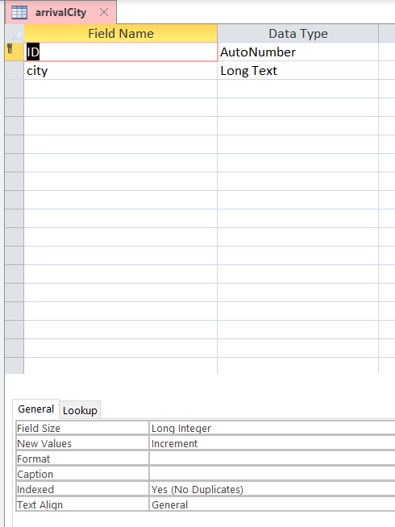
id – Number (Long Integer)
city – Long Text

Slide 19
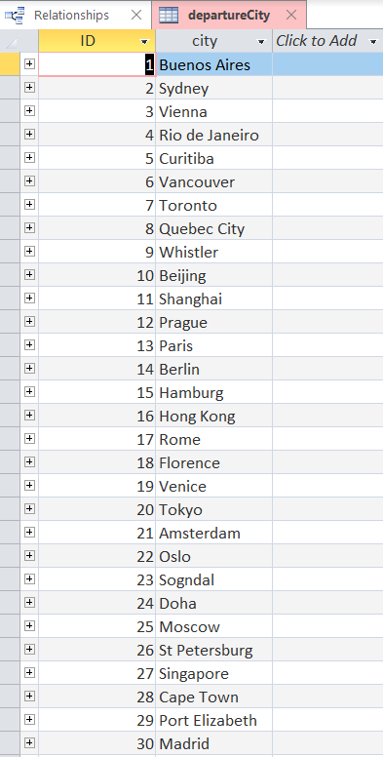
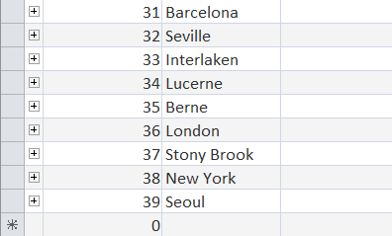
departureCity
2 attributes
*Id
City
Total 39 cities
3NF

Slide 20
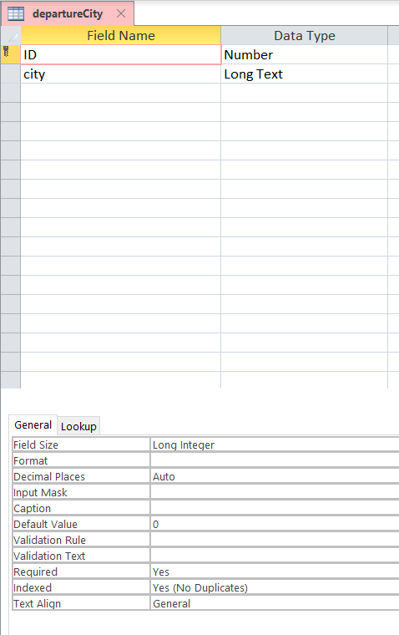
id – Number (Long Integer)
city – Long Text

Slide 21
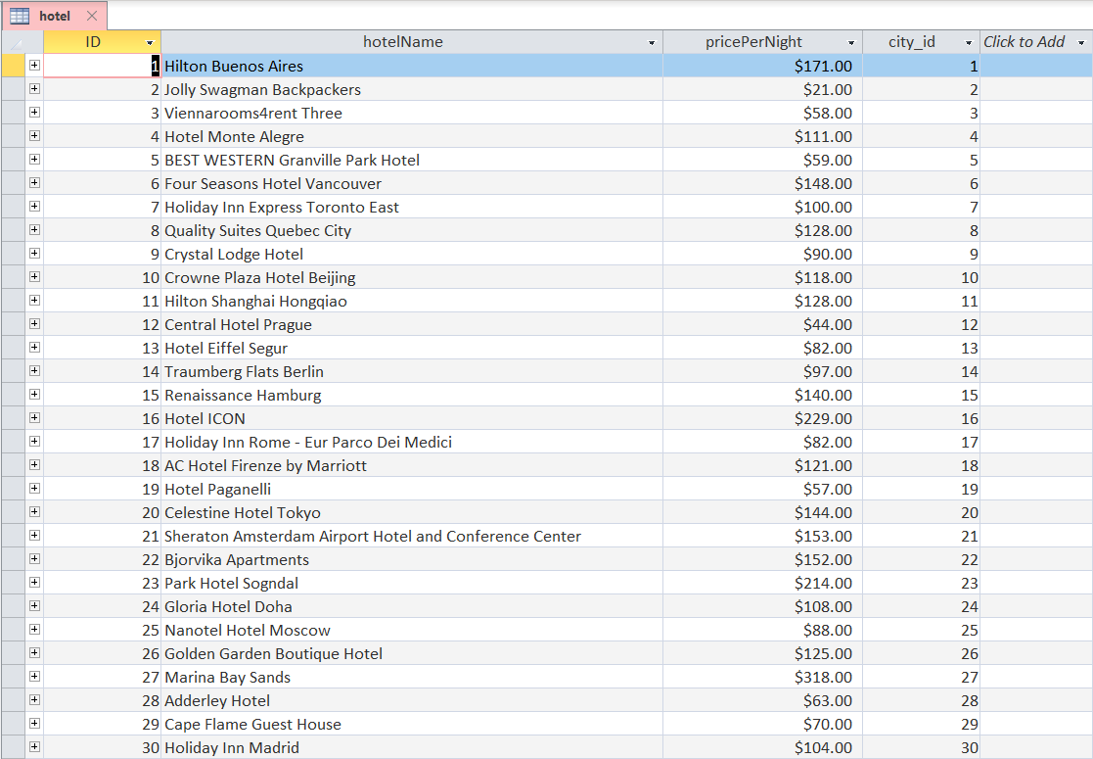
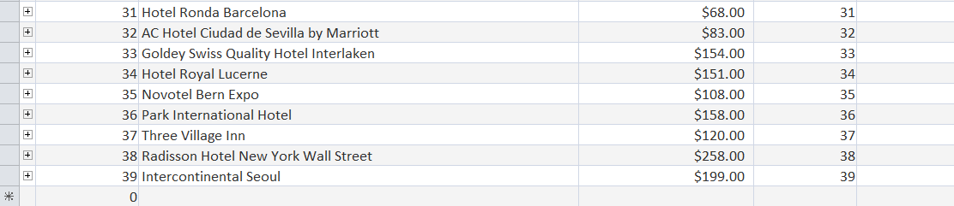
Hotel
4 attributes
*Id
Hotel Name
Price per Night
city_id – FK
Total 39 hotel records
1NF

Slide 22
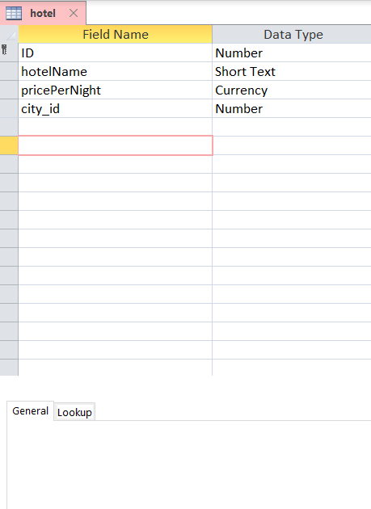
id – Number (Long Integer)
hotelName – Short Text
pricePerNight – Currency
city_id – Number (Long Integer)

Slide 23
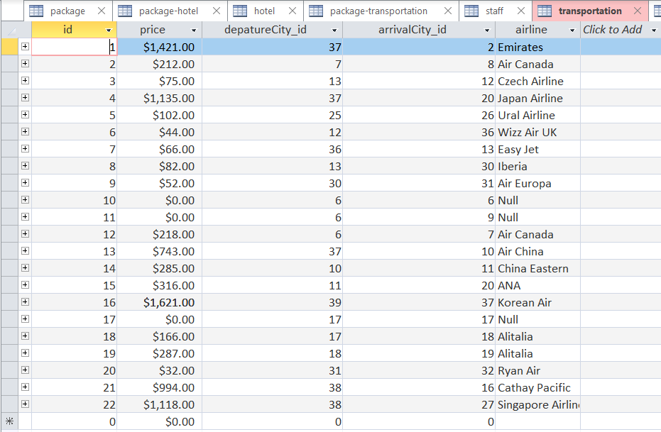
Transportation
5 attributes
*Id
Price
departureCity_id - FK
arrivalCity_id - FK
Airline
Total 22 transportation records
1NF

Slide 24
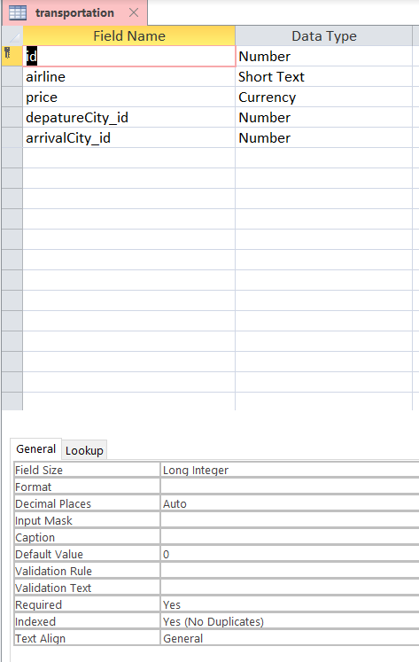
id – Number (Long Integer)
airline – Short Text
price – Currency
departureCity_id – Number (Long Integer)
arrivalCity_id – Number (Long Integer)

Slide 26
Queries
Total 6 interesting queries
Which partner(airline) do we have to focus?
What is most expensive hotel? How much is it per night?
Which city is most popular in our package?
How do we manage staff’s workload
Which customer showed loyalty to our company, Who spend more than $2000 in our company?
Who comes Stony Brook’s 2020 Graduation?

Slide 27
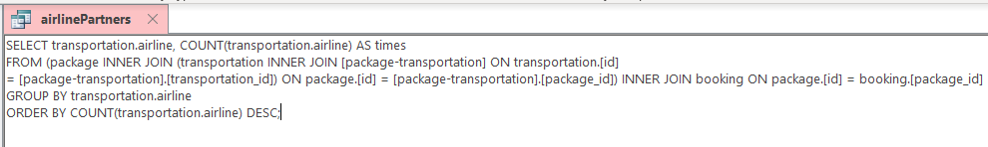
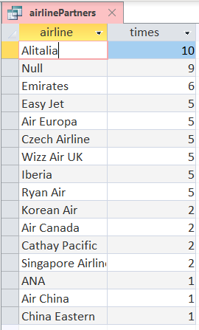
Which partner do we have to focus?
We can use this database to increase airline intimacy
Let Executive board know that build intimacy with which partners

Slide 28

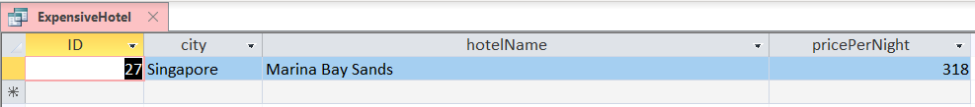
Which hotel is most expensive?
Use this data to compare hotel price to that of other company’s
Some customers want luxury travel

Slide 29
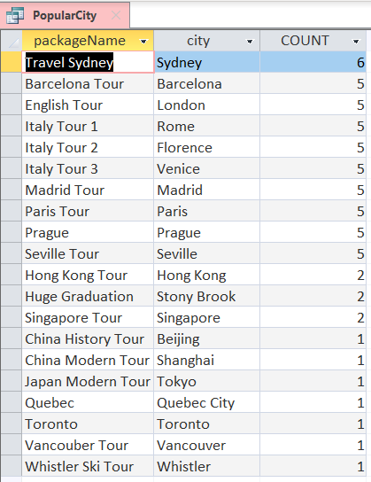
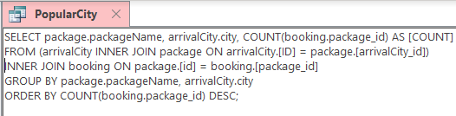
Which city is most popular for tourist?
Count package.id in booking table
Sydney is the most high-demanded city
Useful this data in Package Development Team and Customer Management Dept

Slide 30
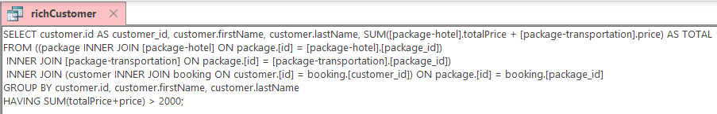
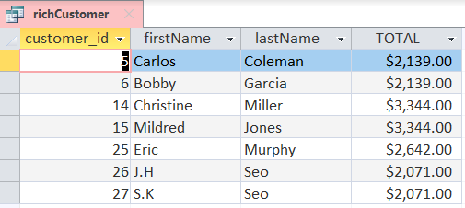
Who are the rich customers?
How much they spend on our company?
Condition : spend more than $2000
Using in Customer Management department

Slide 31
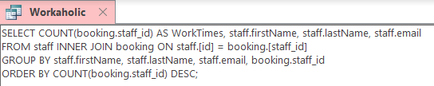
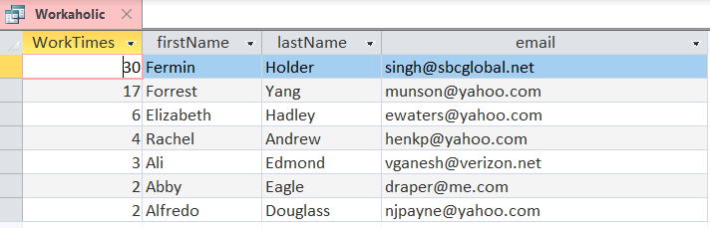
Who is workaholic? How do we manage staff’s workload?
Indicates count staff’s workload as WorkTimes
Fermin Holder is most hard-worker in our company
This data may be using in human resource department

Slide 32
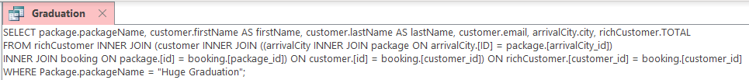
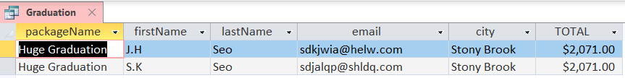
Fun Fact: Who comes 2020 Stony Brook University Graduation?

Slide 33
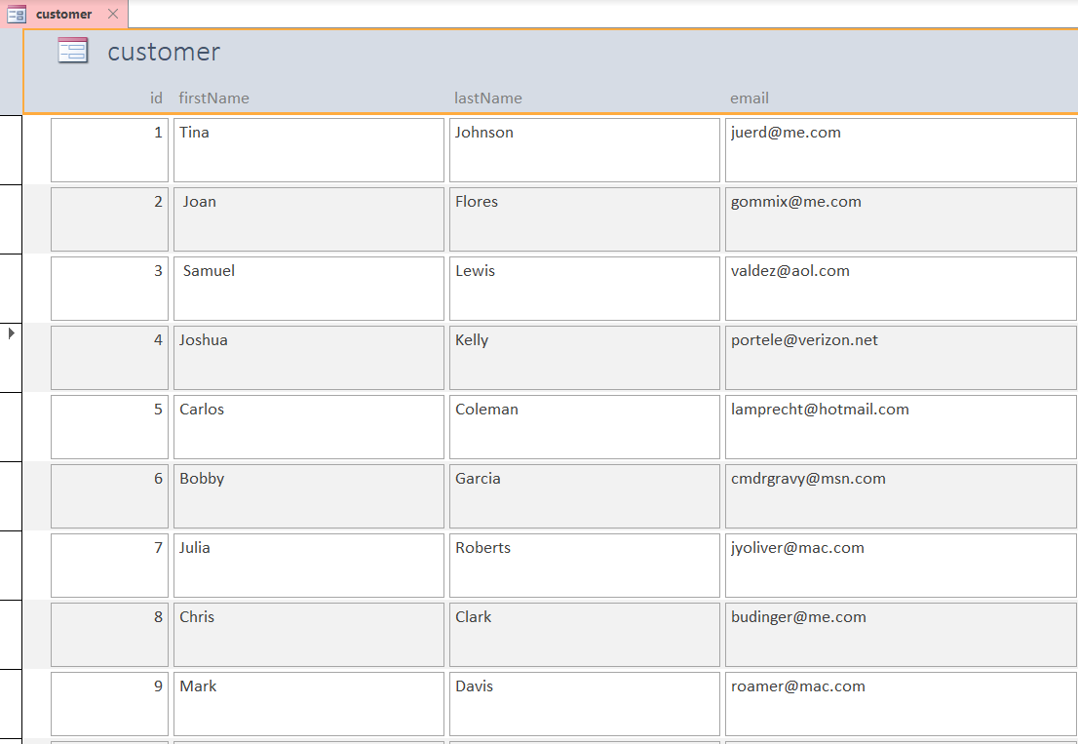
Customer Form
Multiple Item formatted Form
Easy to add records
Easy to view
Easy to know number of customers

Slide 34
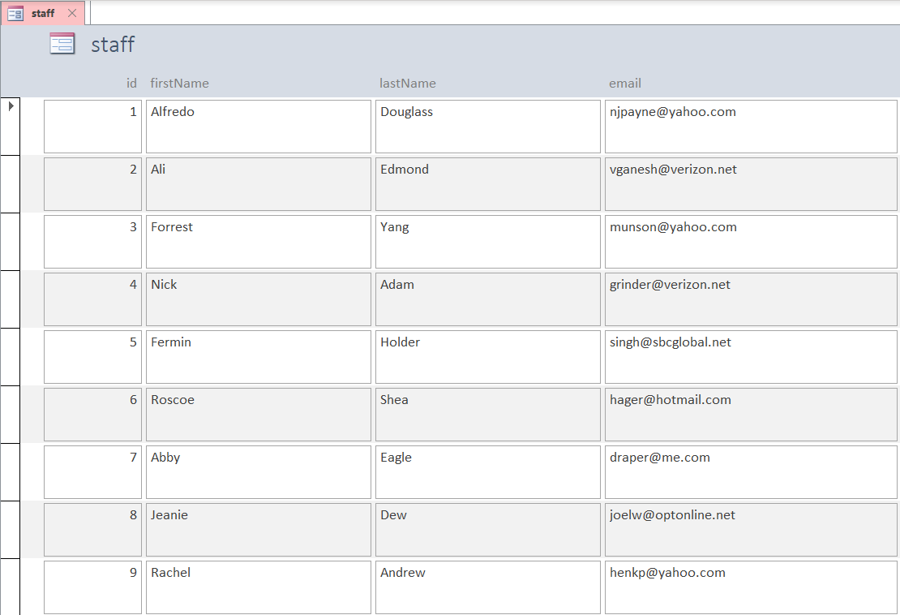
Staff Form
Multiple Item formatted Form
Easy to add records
Easy to view
Easy to know number of staffs

Slide 35
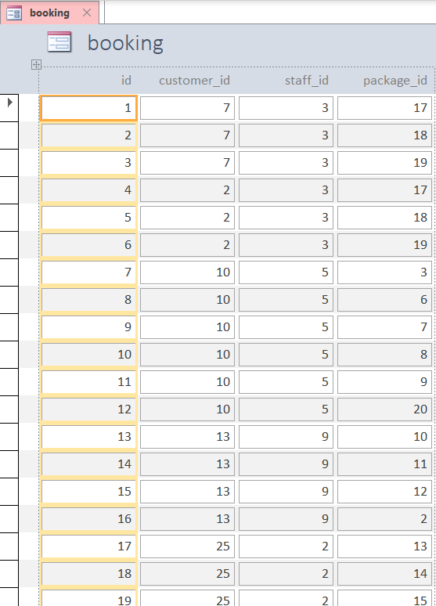
Booking Form
Multiple Item formatted Form
indicates customer booked package that specific staff take charge of

Slide 36
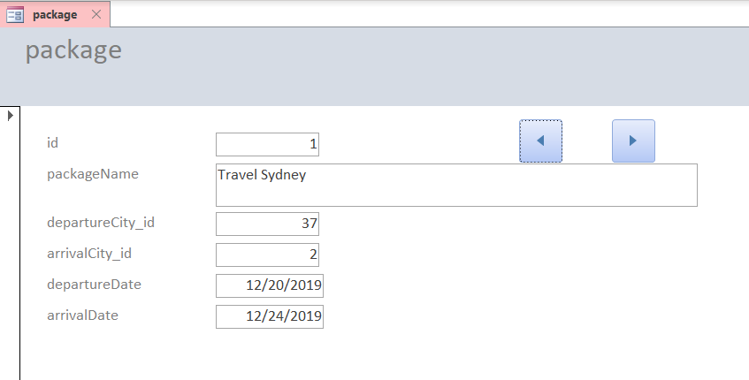
Package Form
Contain each package’s information
Next and Previous button

Slide 37
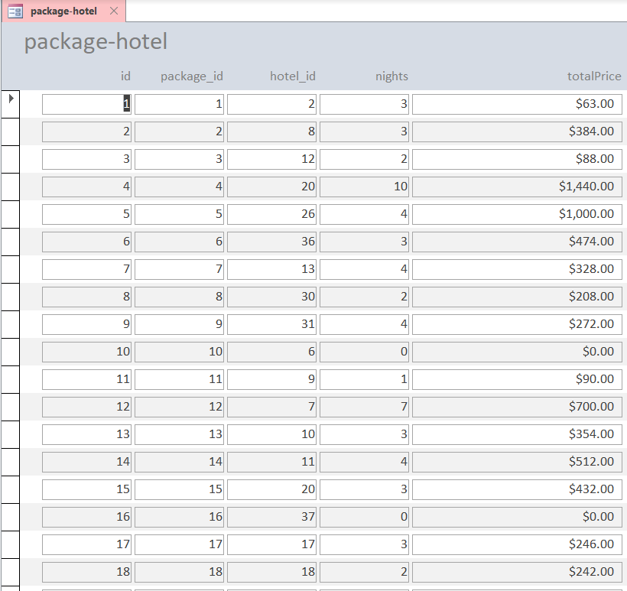
Package-Hotel Form
Each package has duration
This form indicates total hotel price per package

Slide 38
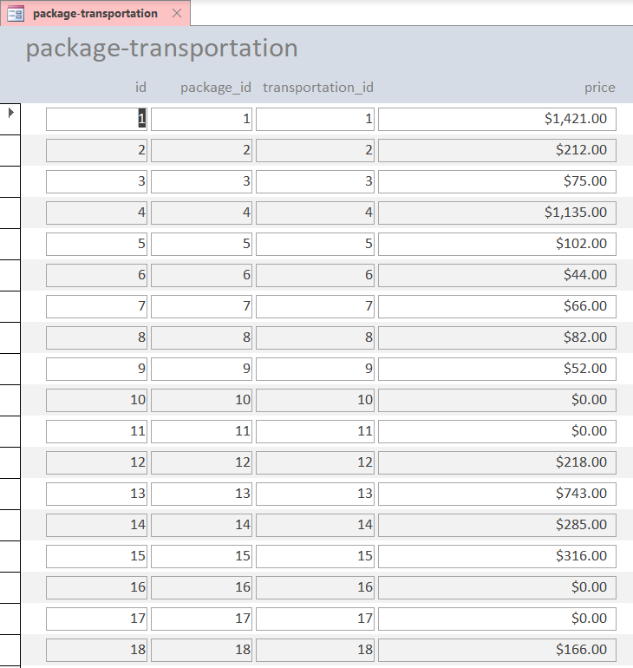
Package-Transportation Form
Each package has transportation (airline)
This form indicates airline price in one way

Slide 39
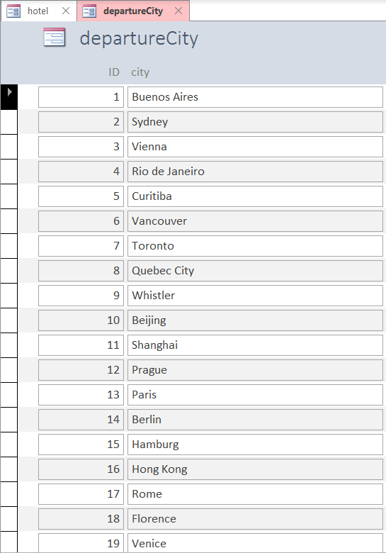
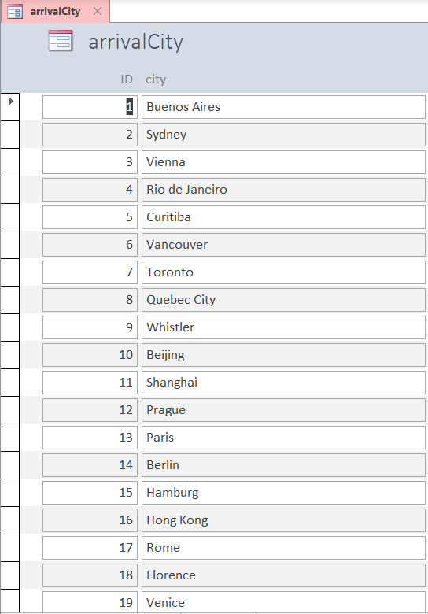
departureCity Form
arrivalCity Form
Contain list of city

Slide 40
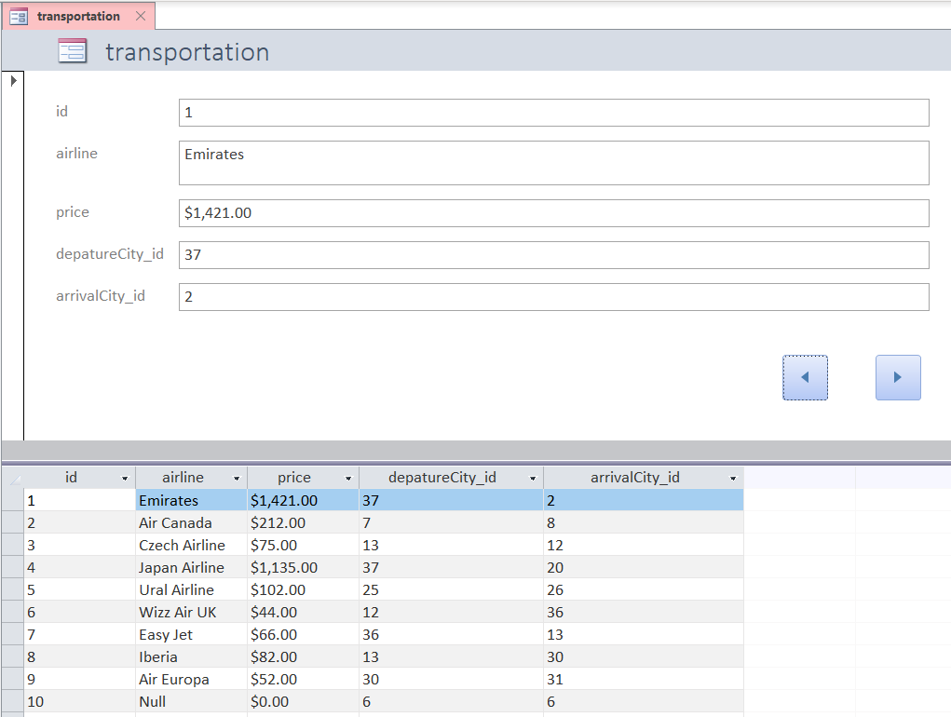
Transportation Form
Split Form
Transportation information such as airline, price, departure and arrival city id
Next and Prev Button

Slide 41
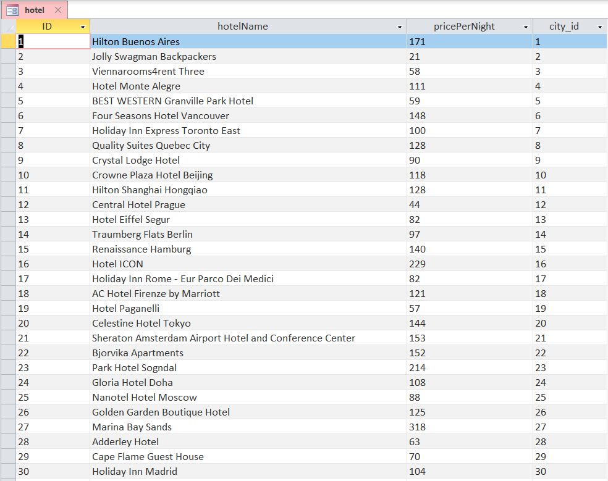
Hotel Form
Datasheet Form
Identical form as Hotel relation
Easy to add hotel information to this list

Slide 42
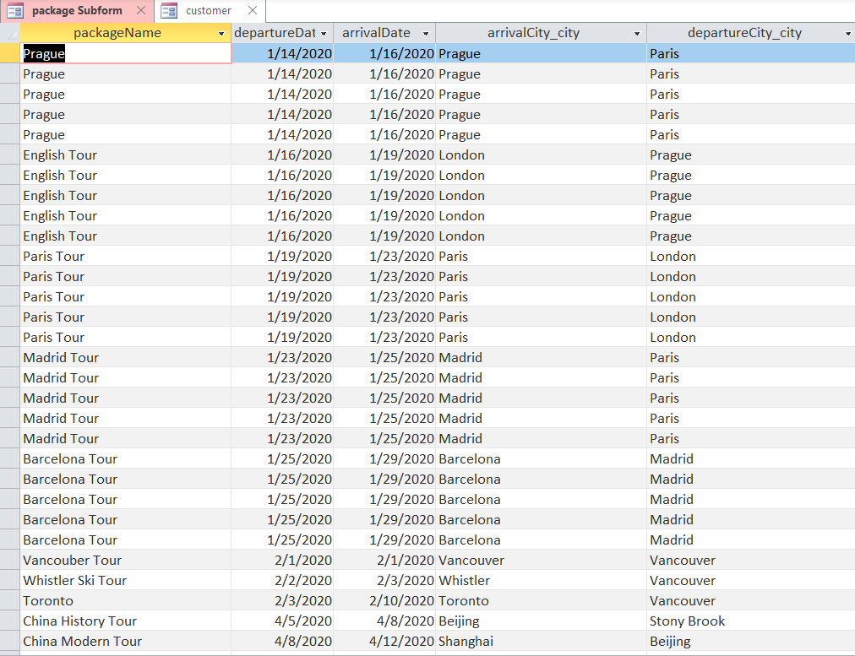
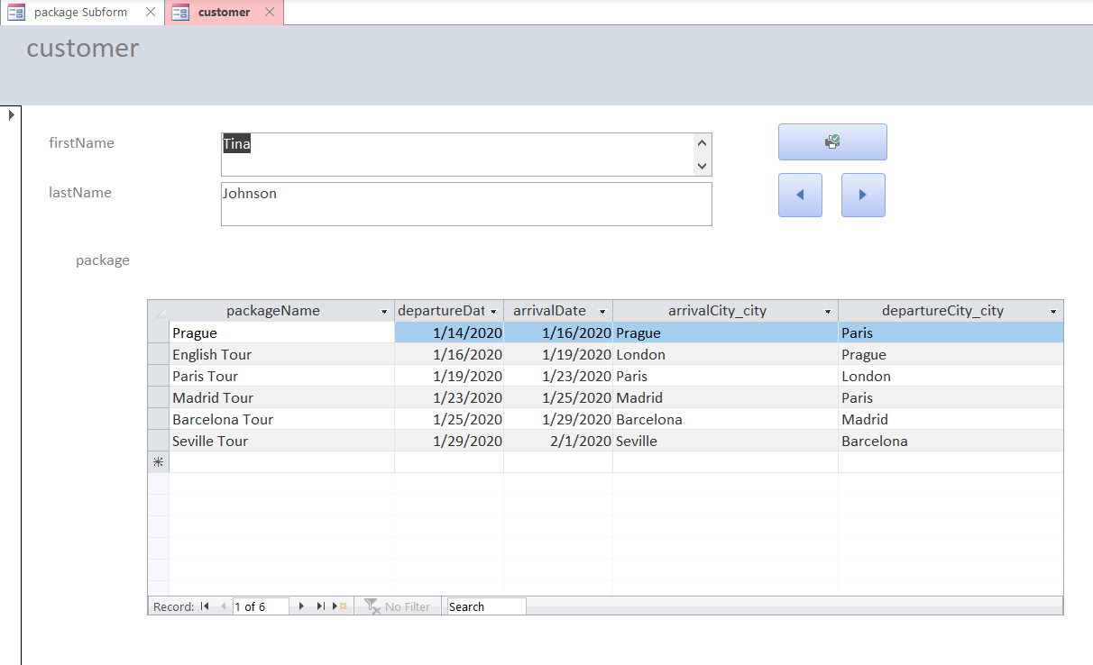
Hierarchical Form
Customer – Package
Show customer’s itinerary
Next / Prev Button
Print Button
Help to manage customer intimacy

Slide 43
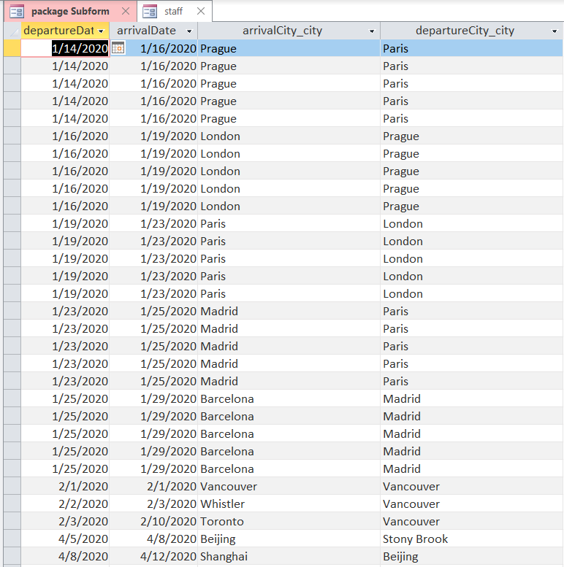
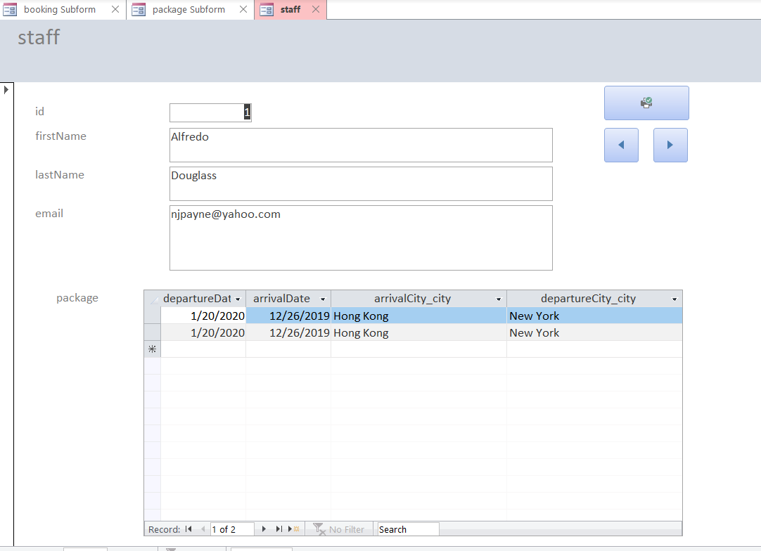
Hierarchical Form
Staff – Package
Show staff’s work schedule
Next / Prev Button
Print Button
Help to manage staff workload

Slide 44

Workload Report
Report Staff’s workload
Show how many times works in our company
Useful in Human Resource Department

Slide 45

Airline Partner
Airline Partner’s Report
Show which airline is most used
Useful in Partner relationship
Let executive board members know which airline is appropriate for our package

Slide 46
Thank You

